Slide 1
Webpage Design
Discussion 2
Evans Li (李奕汎)
2015/10/06

Slide 2
Outline

Slide 3
Outline
Programming

Slide 4
Programming

Slide 5
Submission rules
Submit your work to E-Course.
Deadline：before 10/7 23:59

Slide 6
Office Hour
E-mail:b10023013@gmail.com
Every Wednesday 16:30~18:00 in 117

Slide 7
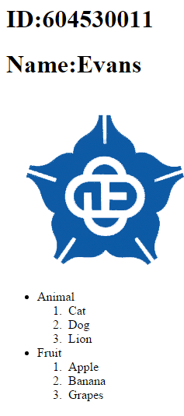
question2.html
Header
Website title：Activity1_1
Body Section
Has your Student ID and your name with <h1> tag.
Insert the image1 that it link to http://www.ccu.edu.tw/ by open the new window.
Has an unordered lists with 2 items in it. And the 2 items all have 3 ordered list in it.

Slide 8
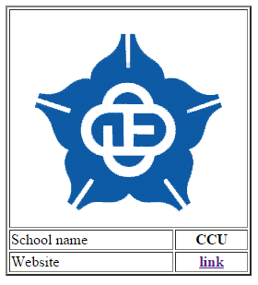
question2.html
Header
Website title：Activity1_2
Body Section
Create a table with 2 column and 4 row.
Table border is 2.
Merger 1 row and insert the image 1 with 80% of its original size
Left row use <td> tag
right row use <th> tag and horizontal centering.
Website can link to www.ccu.edu.tw.

Slide 9
Thanks！

